Slide 1

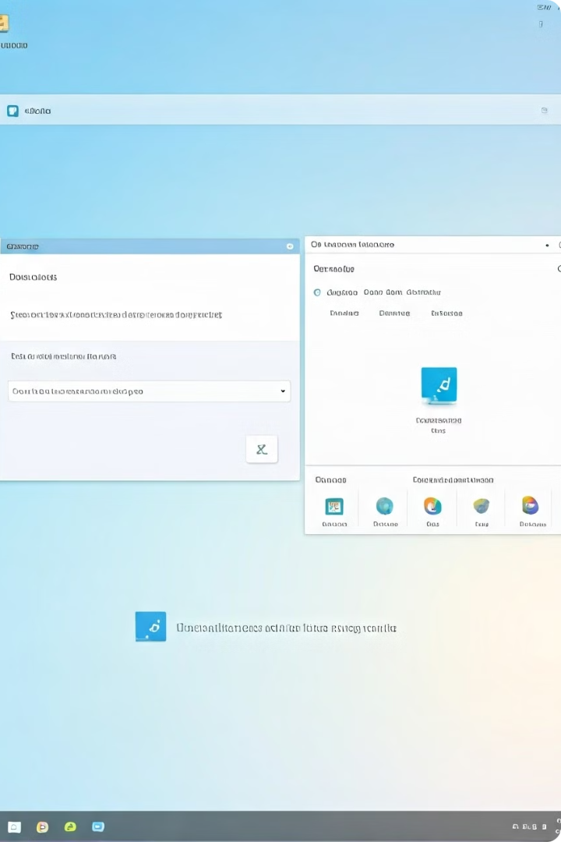

Introduction to the Windows Operating System
Windows is the world's most popular desktop operating system, used by millions of people around the globe. It offers a user-friendly graphical interface, robust security features, and a wide range of applications to meet the needs of both home and business users.
by Mohammad Javad Sharifi

Slide 2
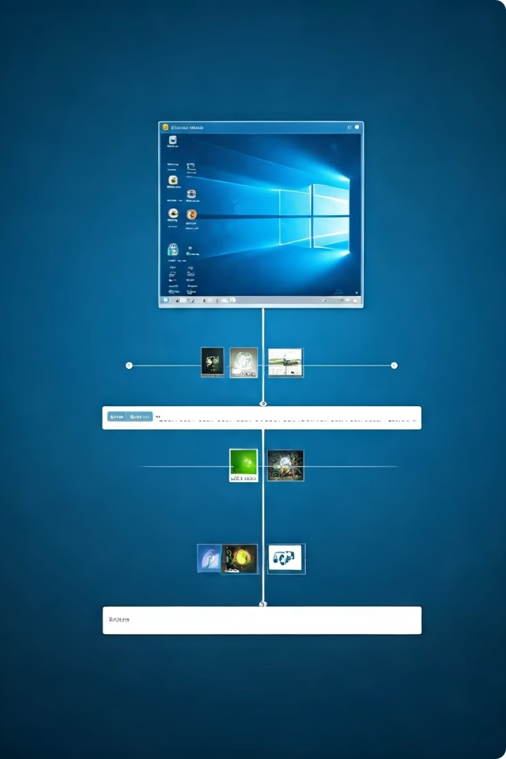
History and Evolution of Windows
1
Windows 1.0 (1985)
The first version of Windows was released, introducing a graphical user interface (GUI) and the ability to multitask.
2
Windows 95 (1995)
A major update that introduced the Start menu, taskbar, and other features that became iconic to the Windows experience.
3
Windows 10 (2015)
The current flagship version of Windows, featuring a streamlined design, improved security, and integration with cloud services.

Slide 3
Windows Versions and Features
Home Editions
Professional Editions
Server Editions
Windows Home editions are designed for personal use, with features like the Microsoft Store, a personalized Start menu, and built-in security tools.
Windows Professional editions offer advanced features for business users, such as remote desktop, domain join, and enterprise-level security policies.
Windows Server editions are designed for enterprise-level IT infrastructure, providing features like active directory, virtualization, and advanced networking capabilities.

Slide 4
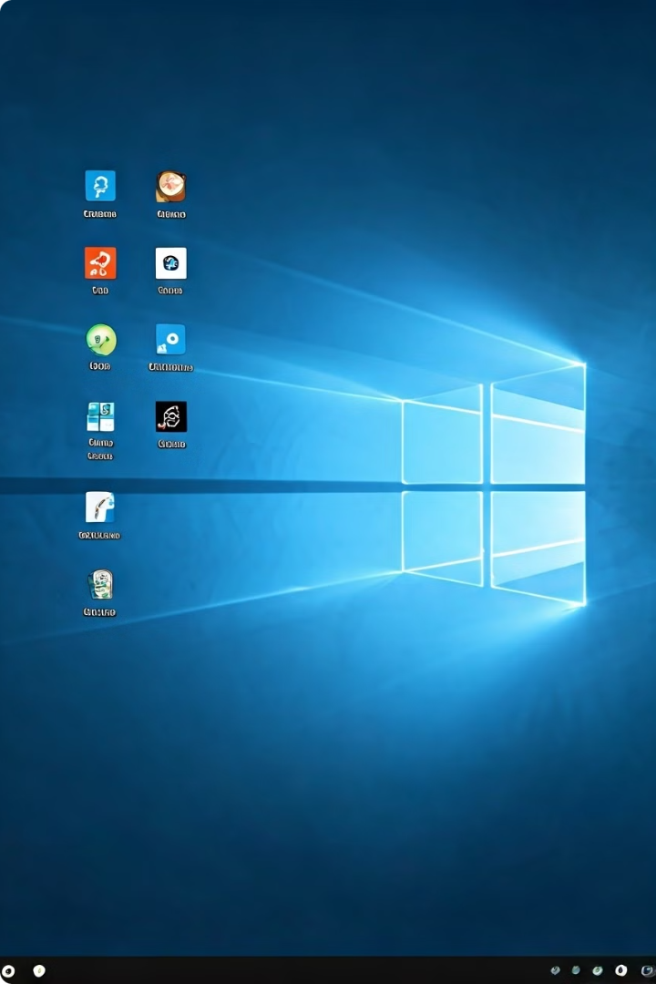
Windows Desktop and User Interface
1
Start Menu
The Start menu provides easy access to apps, documents, and system settings, allowing users to quickly find and launch the tools they need.
2
Taskbar
The taskbar at the bottom of the screen allows users to switch between open applications, pin frequently used apps, and access system information.
3
Action Center
The Action Center consolidates notifications, quick settings, and other system controls in a single, easily accessible location.
4
File Explorer
The File Explorer provides a comprehensive view of the computer's file system, enabling users to navigate, manage, and organize their files and folders.

Slide 5

File Management in Windows
File Explorer
Storage Spaces
The File Explorer allows users to browse, open, and manage files and folders on their local and networked storage devices.
Storage Spaces enables users to create and manage virtual storage pools, providing increased storage capacity and data redundancy.
OneDrive
Search
OneDrive is Microsoft's cloud storage service, allowing users to store, sync, and access their files from anywhere with an internet connection.
Windows provides powerful search capabilities, enabling users to quickly find files, applications, and other system resources based on various criteria.

Slide 6
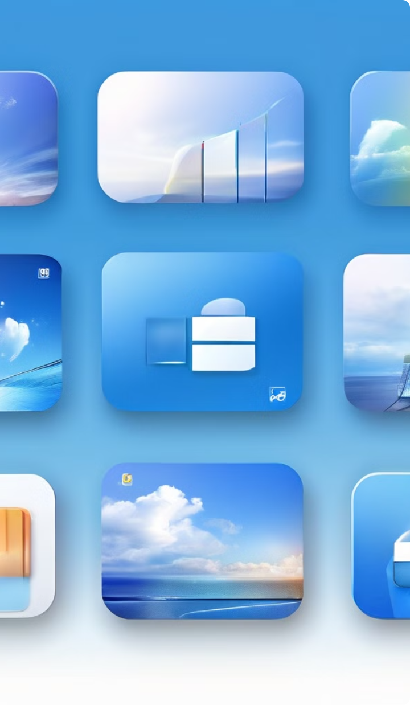




Windows Applications and Software
Microsoft Office
The Microsoft Office suite, including Word, Excel, PowerPoint, and Outlook, is a popular and essential productivity tool for Windows users.
Microsoft Edge
The Microsoft Edge web browser, with its modern design, enhanced security features, and integration with other Windows services, has become a popular choice for Windows users.
Microsoft Store
The Microsoft Store provides a centralized hub for discovering, installing, and managing a wide range of applications, from productivity tools to games and entertainment apps.
Control Panel
The Control Panel offers advanced system settings and configuration options, allowing users to customize various aspects of their Windows experience.

Slide 7





Windows Security and Troubleshooting
Windows Defender
Windows Defender is the built-in antivirus and anti-malware solution, providing real-time protection against a wide range of security threats.
Windows Firewall
The Windows Firewall controls network traffic, helping to prevent unauthorized access and protect the system from external threats.
Windows Update
Windows Update automatically downloads and installs critical security patches and feature updates, ensuring the system remains secure and up-to-date.
Troubleshooting Tools
Windows provides a range of troubleshooting tools, such as the Event Viewer and System Restore, to help users diagnose and resolve various system issues.

Slide 8

Windows Networking and Connectivity
Wireless Networking
Windows supports various wireless networking standards, such as Wi-Fi and Bluetooth, allowing users to connect to the internet and other devices without the need for physical cables.
Remote Desktop
The Remote Desktop feature enables users to access and control their Windows computer remotely, making it easier to work from multiple locations or provide support to others.
VPN Connectivity
Windows includes built-in support for virtual private networks (VPNs), allowing users to securely connect to remote networks and access resources as if they were on the local network.
Homegroup Sharing
Homegroup is a feature that simplifies file and printer sharing between multiple Windows computers on a local network, making it easier to collaborate and access shared resources.

Slide 9
Windows System Administration and Optimization
System Settings
Device Management
Performance Optimization
Windows provides a comprehensive set of system settings, allowing users to customize various aspects of their computer's behavior, from display and sound to power and privacy.
The Device Manager enables users to view, configure, and troubleshoot the hardware devices connected to their Windows computer, ensuring optimal performance and compatibility.
Windows includes various tools and settings to help users optimize system performance, such as disk defragmentation, memory management, and startup optimization.

Slide 10
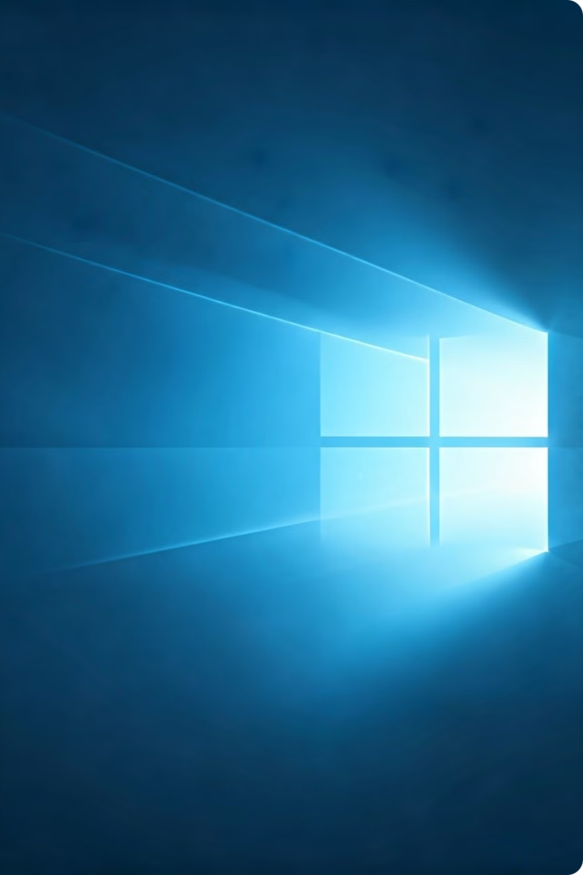
Conclusion and Future Developments
Windows has come a long way since its humble beginnings, evolving into a powerful and versatile operating system that continues to adapt and innovate to meet the changing needs of modern computing. As technology advances, we can expect to see even more exciting developments and enhancements in the future versions of Windows, further cementing its position as a leading choice for both personal and professional users.

